Slide 1
Unit 4: Registers

Slide 2
SISO – 8bit Shift register

Slide 3
SIPO – 8bit Shift register

Slide 6
PISO – 8bit Shift registers

Slide 7
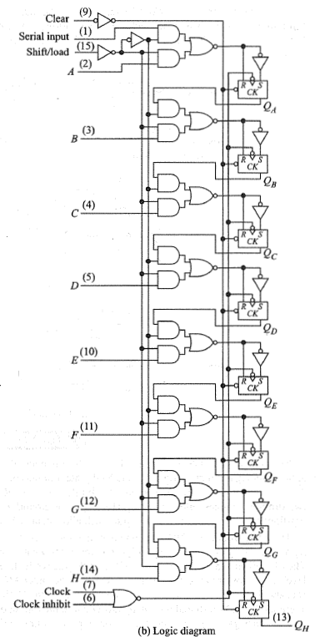

Slide 9
PIPO – 8bit Shift register

Slide 10
PIPO – 4bit Shift register

Slide 11
PIPO – 4bit Shift register

Slide 13
Universal Shift Registers:

Slide 16
Applications of Shift Register:
1. Ring Counter:

Slide 18
2. Switched-Tail Counter or Johnson Counter:

Slide 20
3. Sequence Generator and Sequence Detector:

Slide 21
4. Serial Adder:

